Slide 1
Speed
Physics

Slide 2
Lesson Objective
By the end of this lesson you will be able to describe:
What is speed?
The Formula for speed
Units of Speed

Slide 3
Average Speed
Speed is a measure of how fast an object is travelling.
Speed can be calculated as:
= distance travelled divided by time
v = d /t
v is speed
d is distance travelled
t is time taken.

Slide 4
Calculating Speed
Work out the following speed:
John walked 3 metres in 5 seconds
Sarah walked 5 metres in 20 seconds
Who was fastest?

Slide 5
Solutions
A. 3m / 5s = 0.6m/s
B.5m / 20s = 0.25m/s
C. John was fastest

Slide 6
Units of Speed
Speed is measured in the standard unit meters per second (m/s)
Sometimes you will be asked to convert the speed of an object from meters per second to kilometers per hours

Slide 7
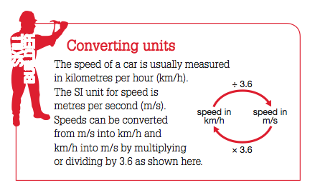

Slide 8
Speed Calculations
Work out the following:
Covert 3 m/s into km/h
Convert 54 km/h into m/s
Theo spent 8 hours travelling 400km/h to visit a friend. Calculate Theo’s distance traveled.

Slide 9
Solutions
A. 3m/s = 3 x 3.6 = 10.8km
B.54km/h =54/ 3.6 = 15m/s
C. v= d/t
= 400/8
= 50km/h

Slide 10
Average Speed
Average speed is the total distance travelled in a journey, divided by the total time taken.
Average speed does not give any indication of how slowly or how quickly you may have travelled in a trip, or how long you were caught in a traffic jam or stopped at traffic lights.

Slide 11
Instantaneous Speed
Instantaneous Speed is speed at any given point in time.
In a car, this is indicated by the speedometer.
If travelling above the speed limit, you can be caught by a mobile speed camera, which measures the instantaneous speed of a car.

Slide 12
Velocity
Velocity is the same as speed but with direction.
A person may ride a bike at a constant speed of 20 km/h. However, every time they change direction, their velocity changes too.
Velocity is a vector quantity (has a direction), while speed is a scalar quantity ( is a measurement)

Slide 13
Measuring speed
There are different ways of measuring speed.
Light gates can be used to time sporting events such as downhill skiing
. Light gates use a sensor to trigger an electronic timing mechanism when an object breaks through a light beam.
A motion sensor sends out pulses of radiation, such as ultrasonic sound waves, microwaves or infrared radiation.
The reflection of this radiation from an object provides data about its position and speed.

Slide 14
Ticker Timer
A ticker timer consists of a small electric arm with a pin or hammer on its end.
The hammer vibrates up and down 50 times per second, synchronised with the alternating current of 50 Hz supplying its power.
The hammer hits a piece of carbon paper that leaves a dot on a strip of paper threaded below it. When the timer is attached to an object moving in a straight line, these dots are a record of its motion

Slide 15
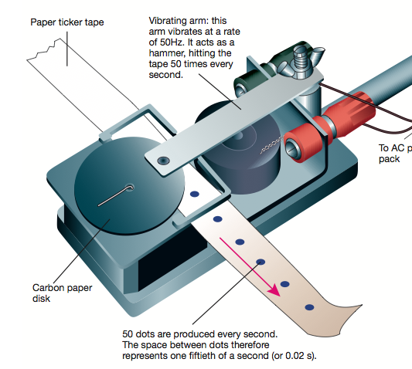
.

Slide 16
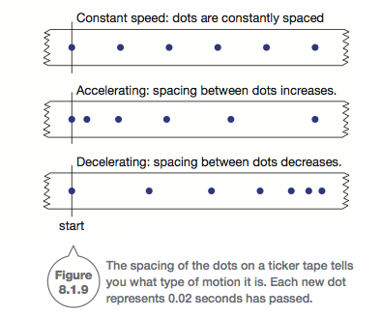

Slide 17
Recall
30 seconds think time
What is instantaneous speed?
What is velocity?

Slide 18
Recall
30 seconds think time
What is formula to calculate speed?
How do you convert m/s into km/hr?

